Slide 1
DESIGN AND VERIFICATION OF AXI 4 LITE TO SDRAM USING UVM FRAMEWORK
UNDER THE GUIDANCE OF
MR SUYASH JAIN
PRESENTED BY
A Siva Kalyan 240480133002
J Eswar 240480133011
Krushitha B 240480133015
M Jayavardhini 240480133017
P Roshan 240480133021

Slide 2
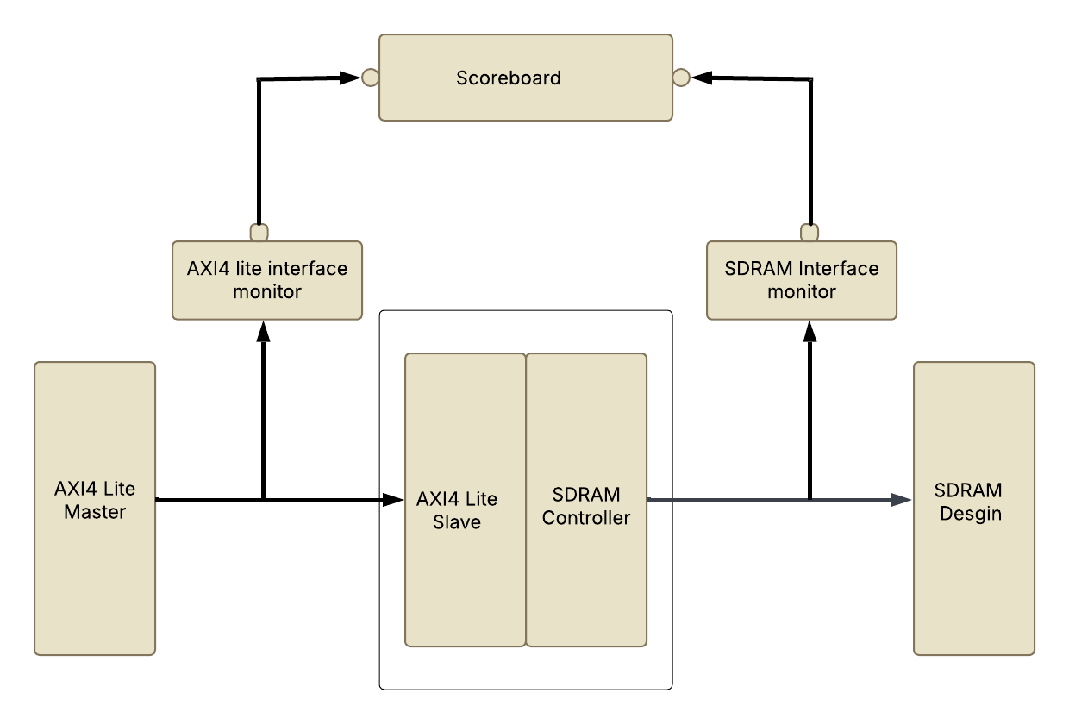
BLOCK DIAGRAM

Slide 3
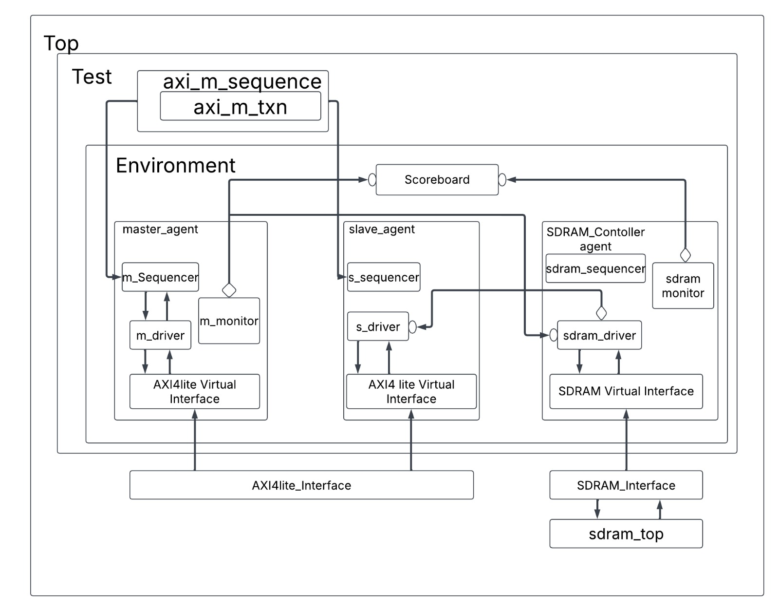
UVM FRAMEWORK

Slide 4
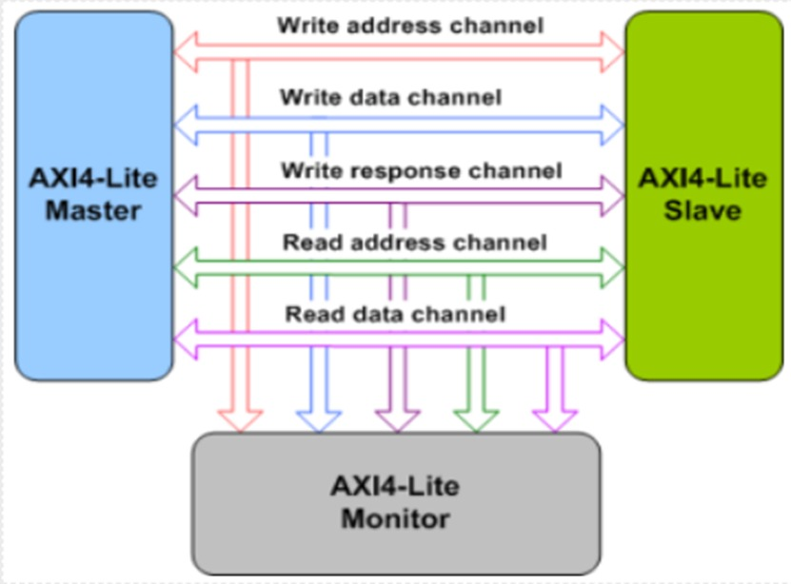
INTRODUCTION TO AXI 4 LITE

Slide 5
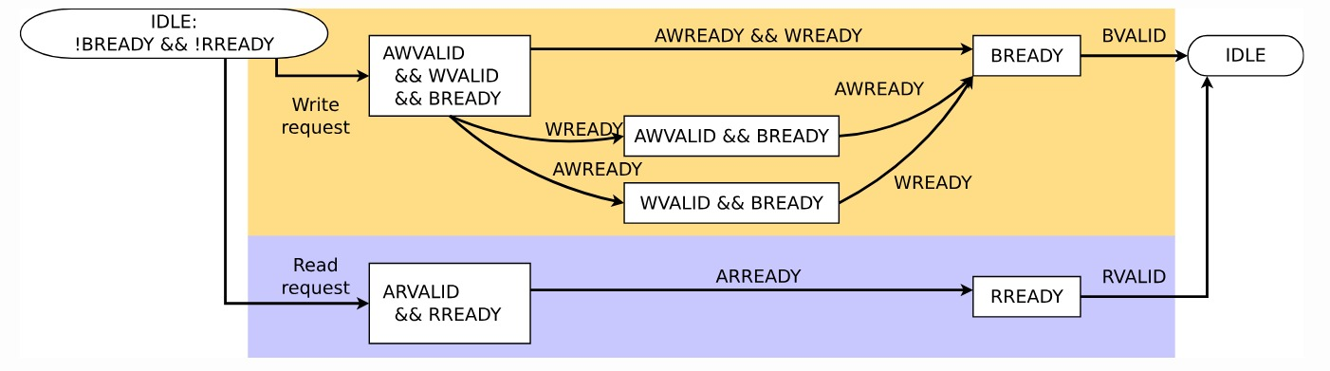
AXI STATE MACHINE

Slide 6
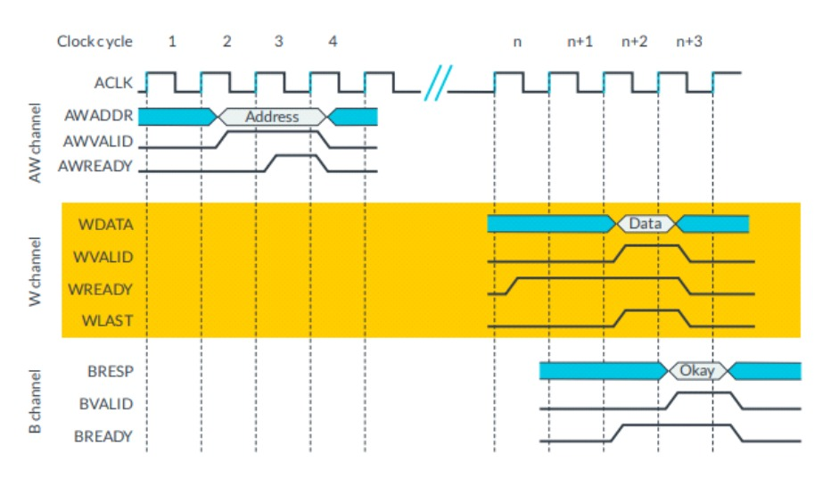
WRITE CHANNEL

Slide 7
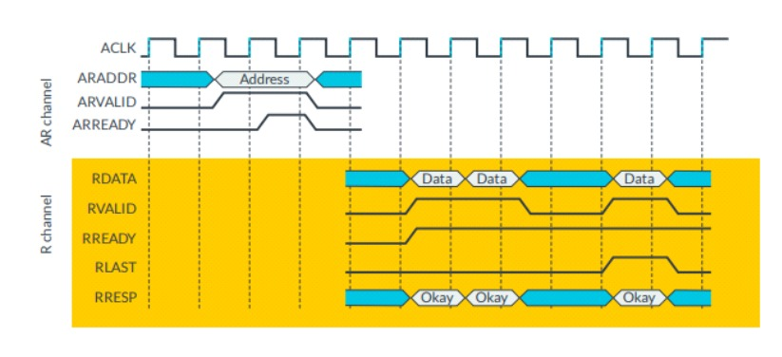
READ CHANNEL

Slide 8
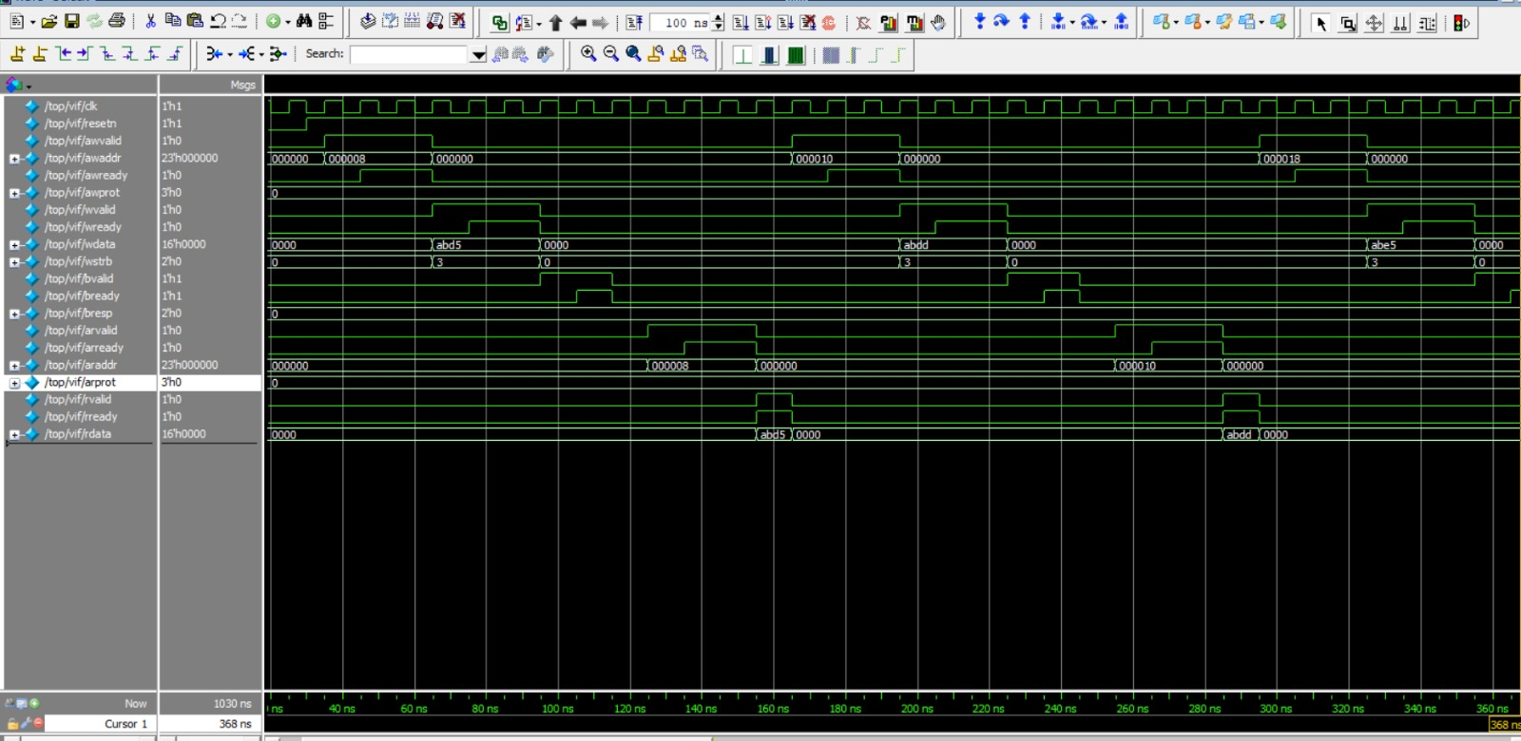

Slide 9
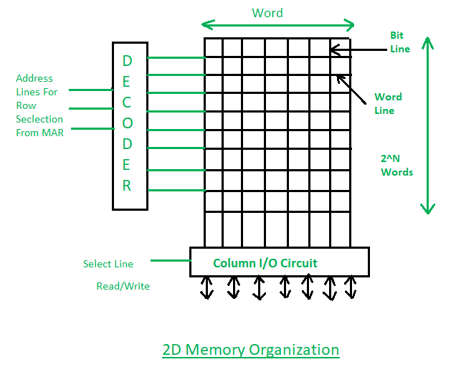
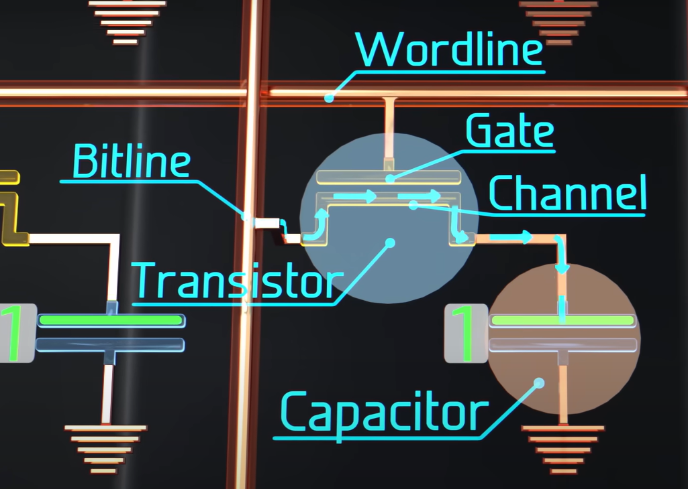
INTRODUCTION TO SDRAM

Slide 10
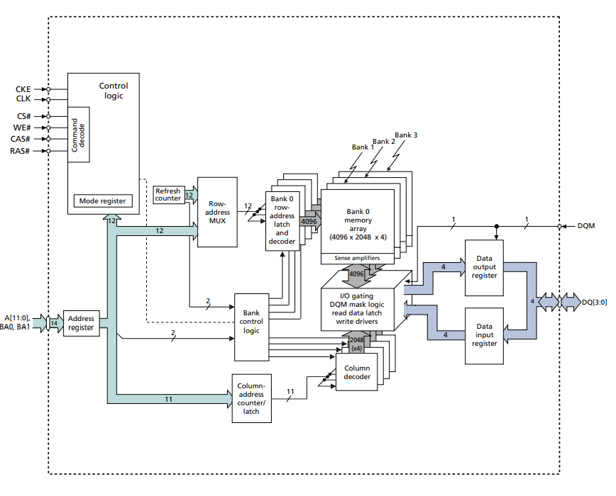

Slide 11
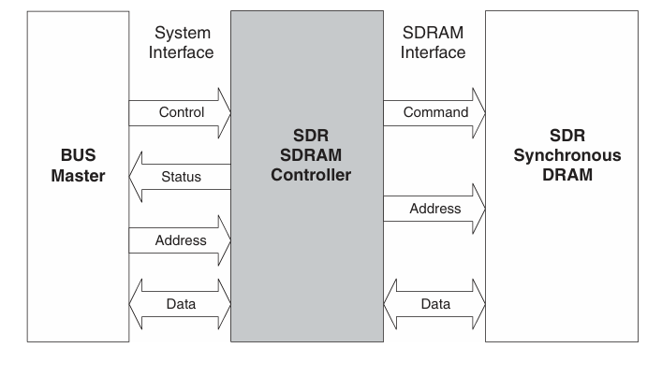
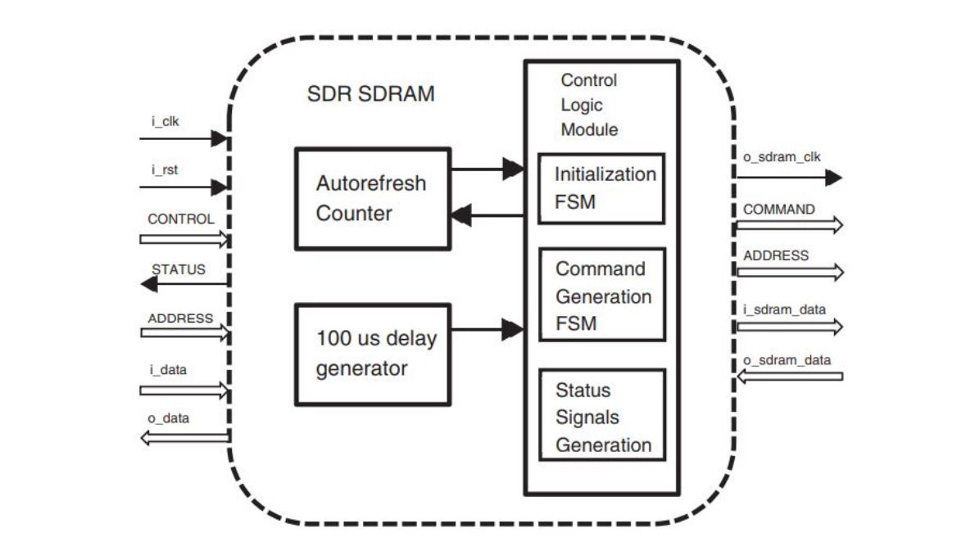
SDR SDRAM CONTROLLER

Slide 12
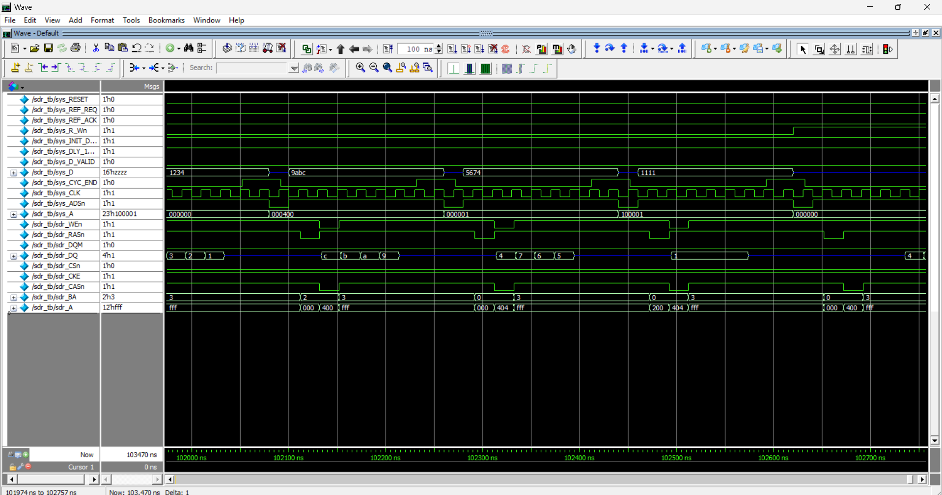

Slide 13
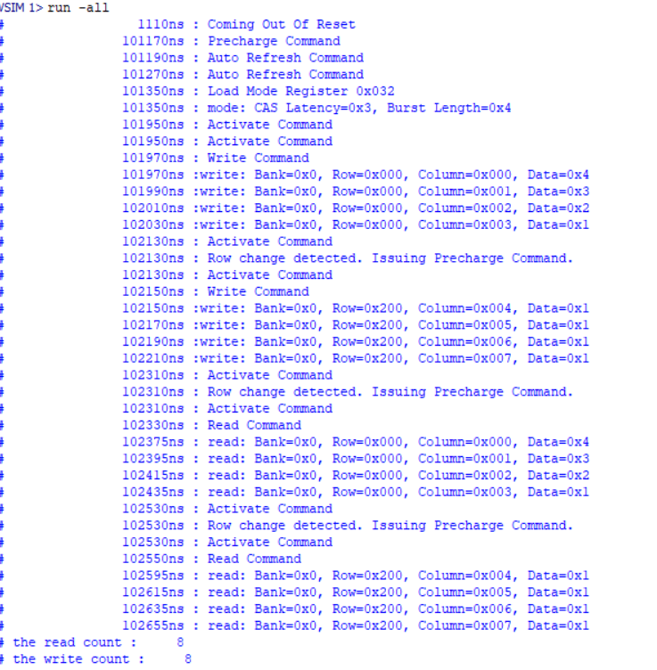
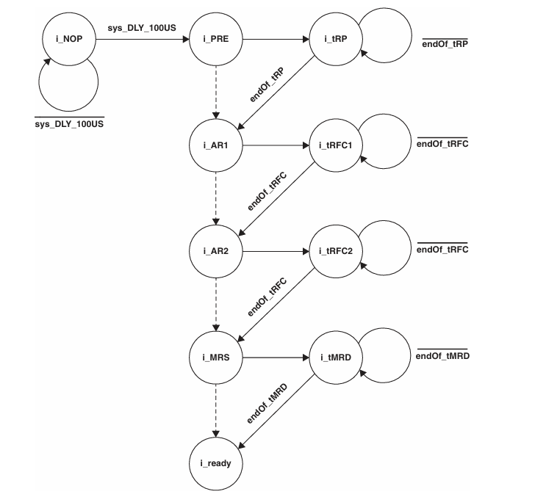

Slide 14
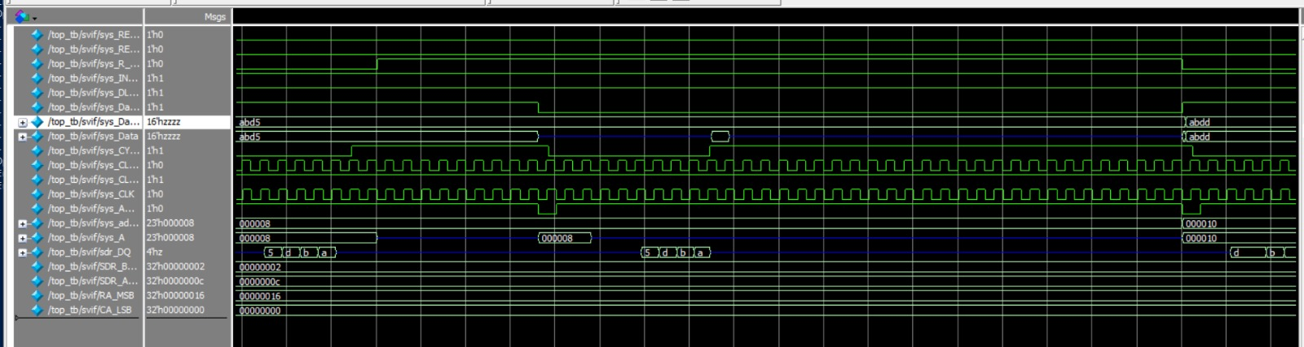
INTEGRATION RESULTS

Slide 15
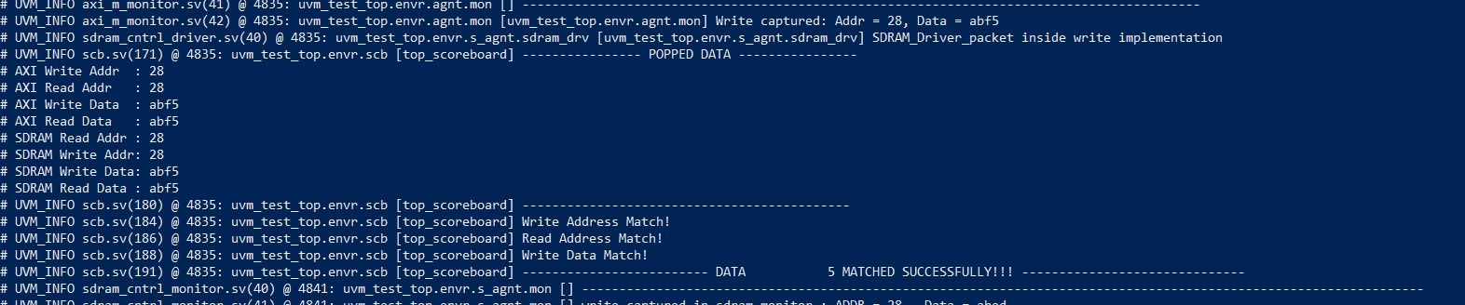
SCOREBOARD RESULTS

Slide 16
FUTURE SCOPE
Many modern SoCs use AXI4-Lite for control path and SDRAM for external storage, making this a relevant design for low-bandwidth memory-mapped applications.
Power-efficient devices rely on lightweight memory interfaces. An optimized AXI4-Lite to SDRAM bridge ensures efficient memory access with minimal overhead.
Low-power SDRAM controllers for mobile/IoT applications. Protocol Enhancements: Supporting error correction (ECC), power-down modes, and efficient address translation for SDRAM mapping.

